Slide 1


Computer Vision
Real-Time Monocular Depth Estimation
in low resources devices.
Damiano Imola – 2109063
Prof: Irene Amerini

Slide 2
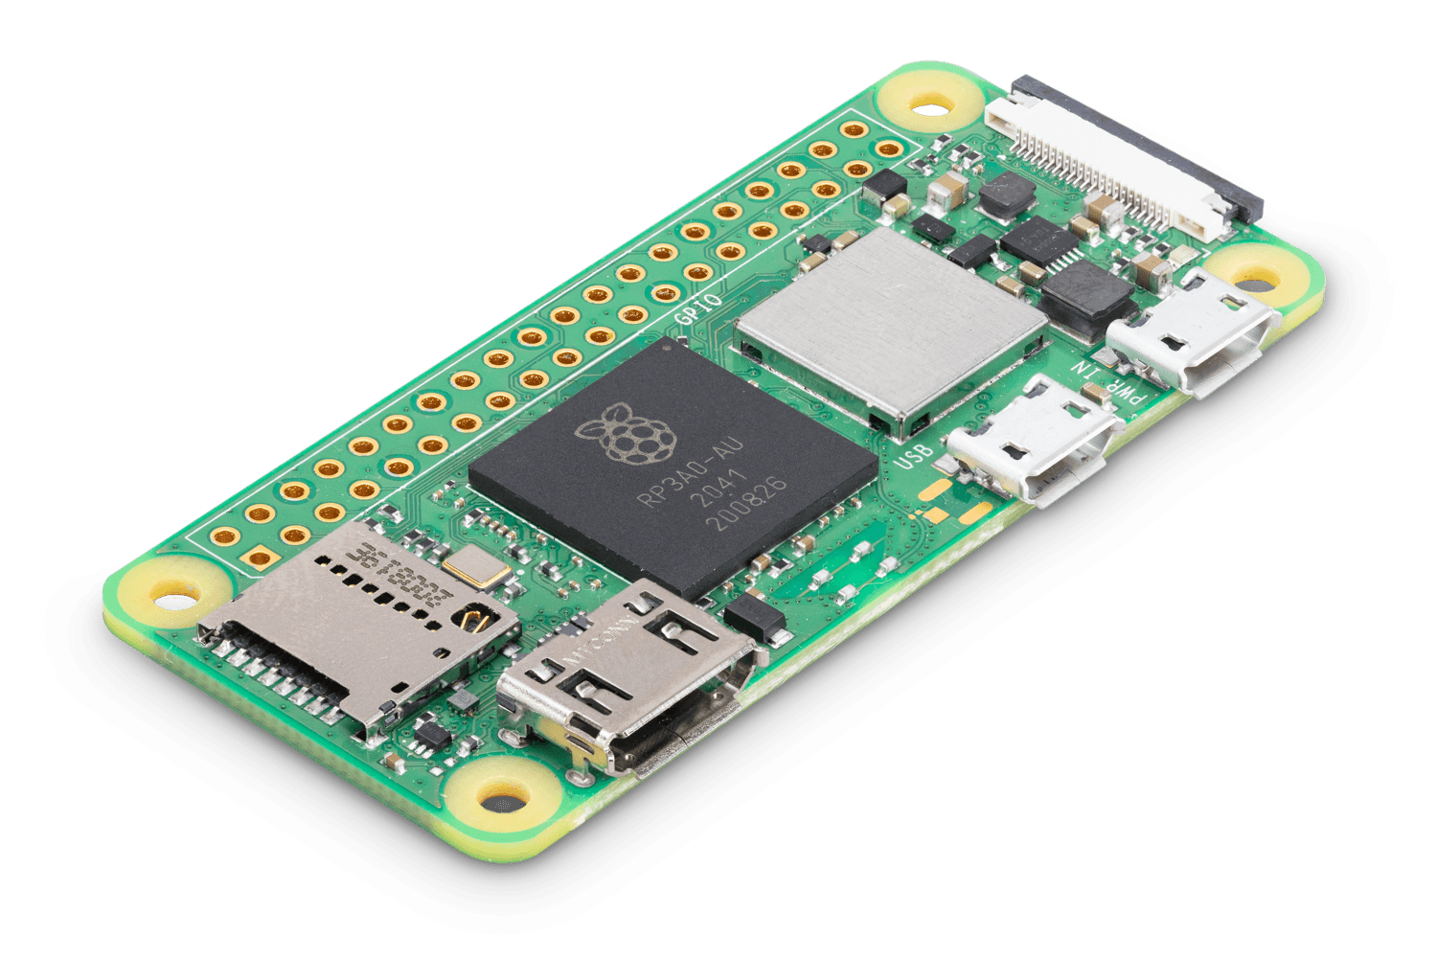

The Fail
1GHz single-core CPU
512MB RAM
Mini HDMI® port
Micro USB OTG port
Micro USB power
HAT-compatible 40-pin header
Composite video and reset headers
CSI camera connector (v1.3 only)
Raspberry Pi
Zero W

Slide 3
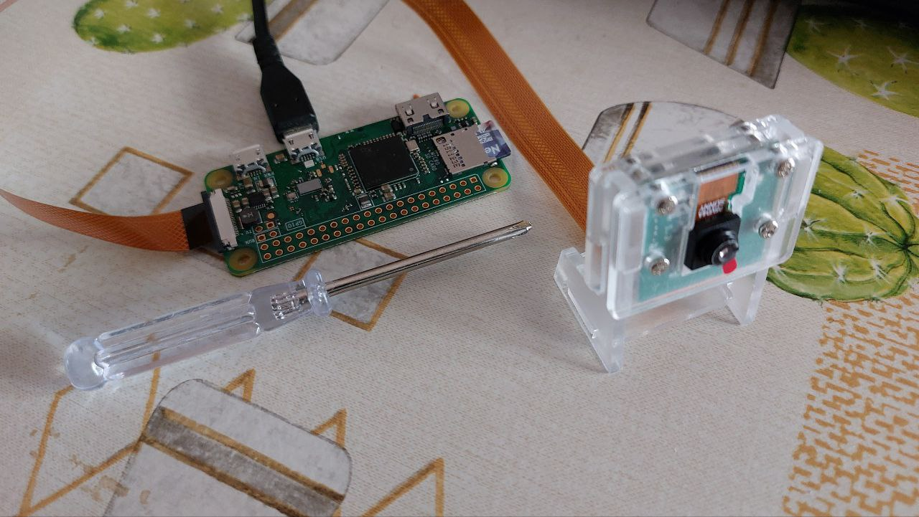
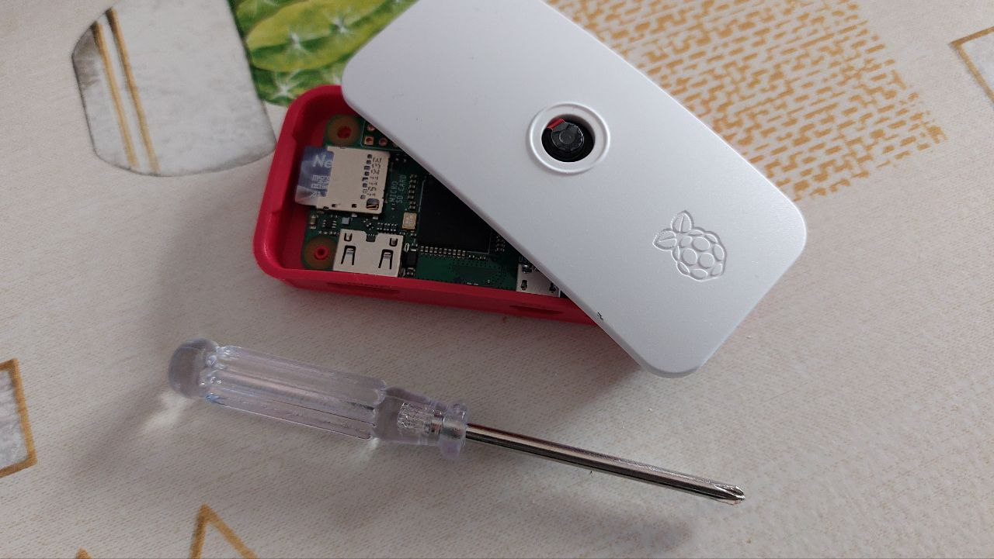
The Fail
Raspberry Pi Zero W
camera stand
Original Raspberry Pi
Zero W camera cover

Slide 4
The Fail

Slide 5
Computer Vision
MonoDeRT:
A novel light-weight Real-Time architecture
for Monocular Depth Estimation.
Damiano Imola – 2109063
Prof: Irene Amerini

Slide 6

Introduction
Related works
Proposed methods
Dataset and metrics
Experimental results
Conclusion

Slide 7
Introduction
Related works
Proposed methods
Dataset and metrics
Experimental results
Conclusion

Slide 8
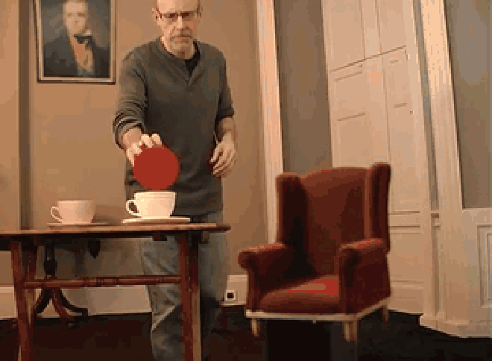
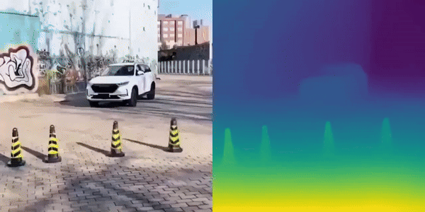
Introduction – The ill-posed problem

Slide 9

Introduction – The applications

Slide 10

Introduction – Challenges (1)

Slide 11
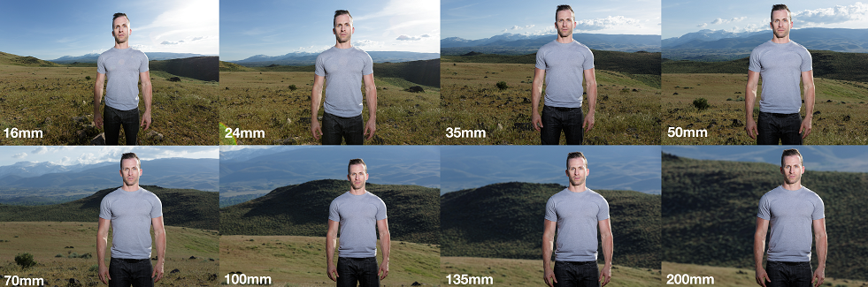
Introduction – Challenges (2)

Slide 12

Introduction – Challenges (3)

Slide 13
Introduction – Challenges (2)
«The model not only has to handle images taken with different cameras and camera settings but also has to learn to adjust for the large variations in the overall scale of the scenes.»

Slide 14

Introduction - Challenges
The scale variation problem
The Real-Time challenge
The lightweight challenge

Slide 15

Introduction - Challenges
The depth challenge
The Real-Time challenge
The lightweight challenge

Slide 16

Introduction - Challenges
The depth challenge
The Real-Time challenge
The lightweight challenge

Slide 17
Introduction
Related works
Proposed methods
Dataset and metrics
Experimental results
Conclusion

Slide 18
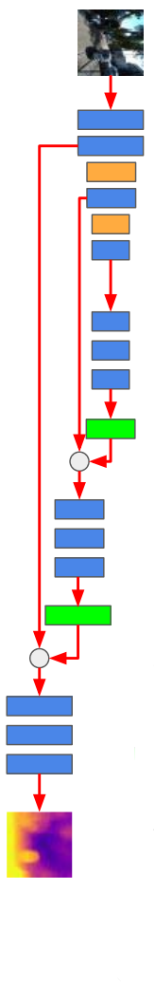
Related works
Size: 32x32 then super resolution.
1 FPS with 512KB Ram
μPyD-Net (MCUs)
RT MonoDepth
MonoDepth2

Slide 19
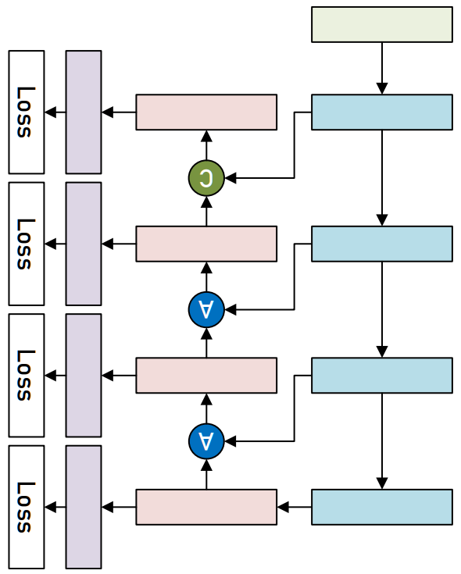
Related works
Additional “-S” variant.
18.4&30.5 FPS on NVIDIA Jetson Nano
μPyD-Net (MCUs)
RT MonoDepth
MonoDepth2

Slide 20
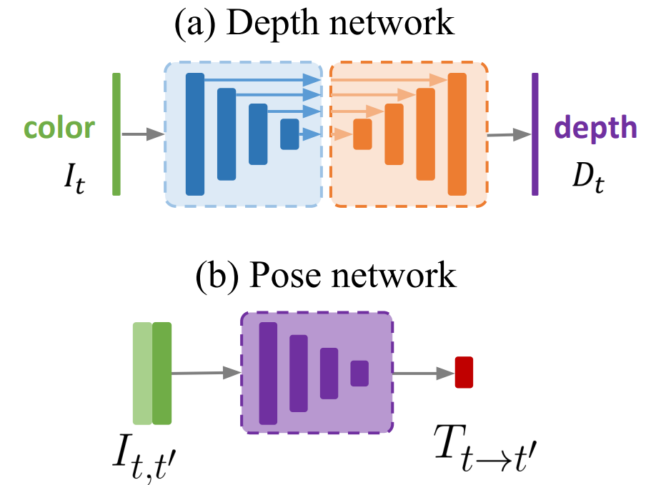
Related works
Leverages self-supervision
Developed new occlusion handling method and Edge-Aware Smoothness Loss.
μPyD-Net (MCUs)
RT MonoDepth
MonoDepth2

Slide 21
Introduction
Related works
Proposed methods
Dataset and metrics
Experimental results
Conclusion

Slide 22
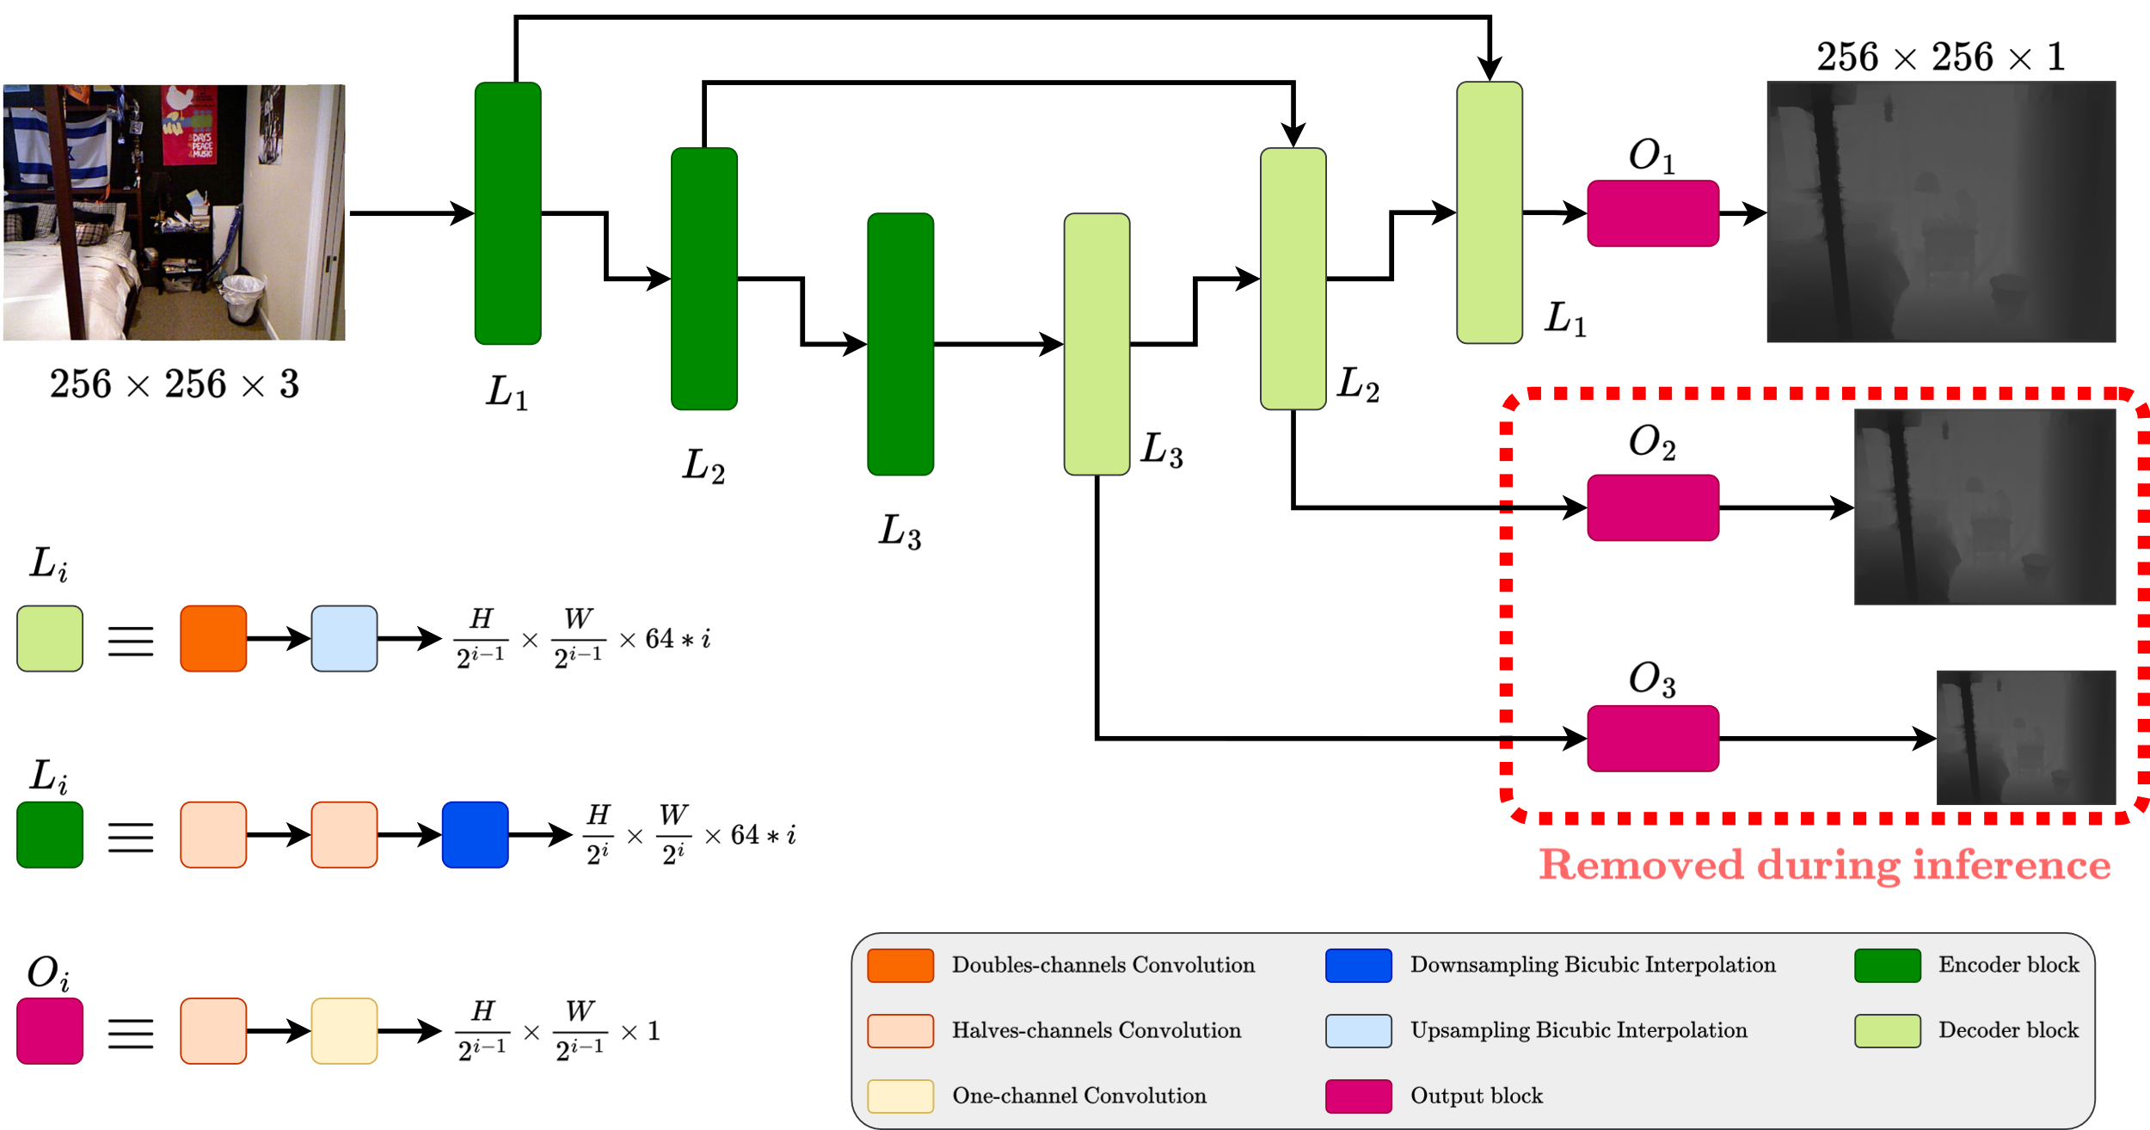
Proposed methods: MonoDeRT

Slide 23
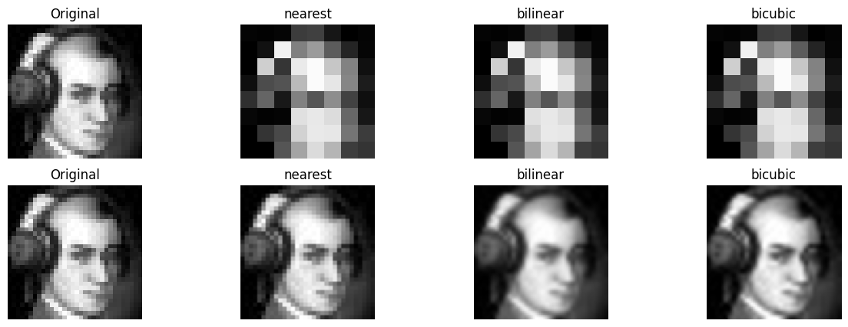
Down-/Up-sampling with interpolation

Slide 24
Introduction
Related works
Proposed methods
Dataset and metrics
Experimental results
Conclusion

Slide 25

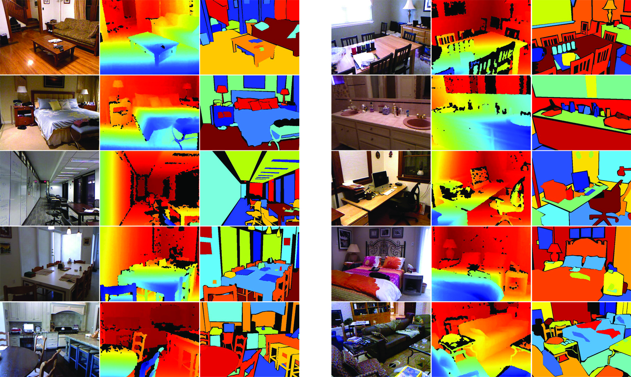
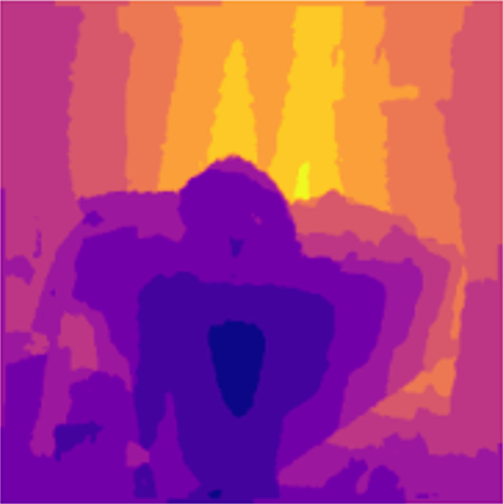
Dataset: NYU Depth Dataset V2
~408.000 total samples
Trained against ~50.000 samples

Slide 26
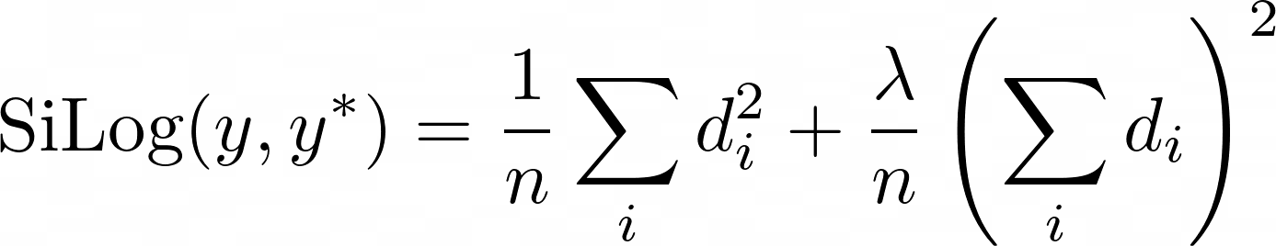
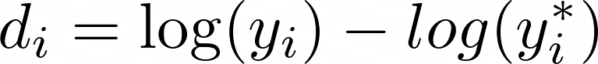
Losses
SiLog (Scale-Invariant Logarithmic error) Absolute scale of depth values can vary widely depending on the scene.
BerHu (Reverse Huber)
SSIM (Structural similarity index measure)

Slide 27
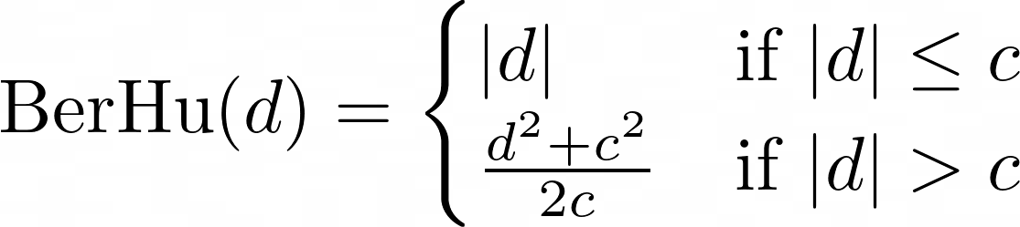
Losses
SiLog (Scale-Invariant Logarithmic error)
BerHu (Reverse Huber)
Particularly effective in managing outliers, which
are common in depth estimation tasks.
SSIM (Structural similarity index measure)

Slide 28
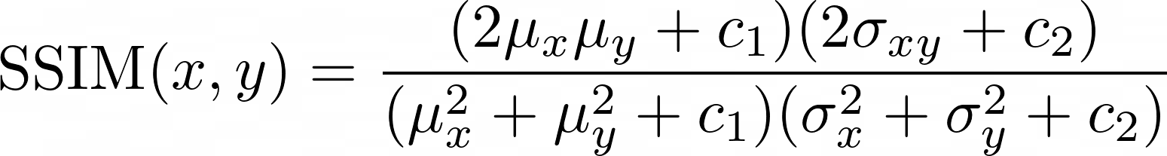
Losses
SiLog (Scale-Invariant Logarithmic error)
BerHu (Reverse Huber)
SSIM (Structural similarity index measure)
Measures the perceptual similarity between the predicted and ground truth depth maps. To make prediction aligned with human perception.

Slide 29
Losses
SiLog (Scale-Invariant Logarithmic error) Absolute scale of depth values can vary widely depending on the scene.
BerHu (Reverse Huber)
SSIM (Structural similarity index measure)

Slide 30
Losses
SiLog (Scale-Invariant Logarithmic error)
BerHu (Reverse Huber)
particularly effective in managing outliers, which
are common in depth estimation tasks.
SSIM (Structural similarity index measure)

Slide 31
Losses
SiLog (Scale-Invariant Logarithmic error)
BerHu (Reverse Huber)
SSIM (Structural similarity index measure) Measures the perceptual similarity between the predicted and ground truth depth maps. To make prediction aligned with human perception.

Slide 32
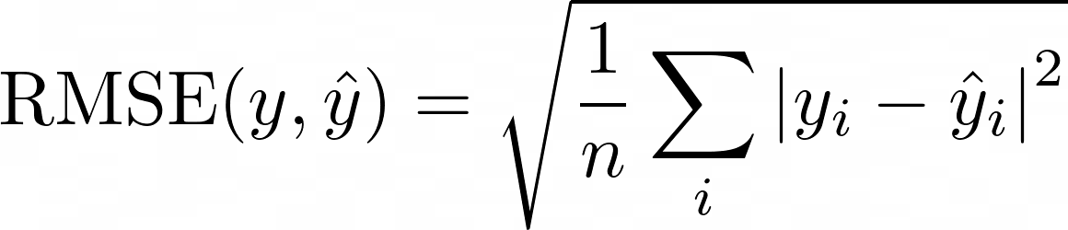
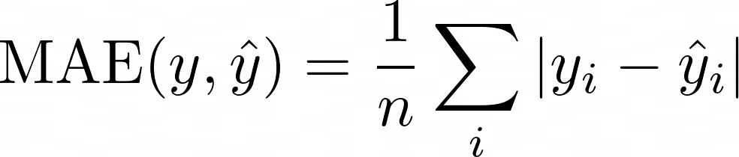
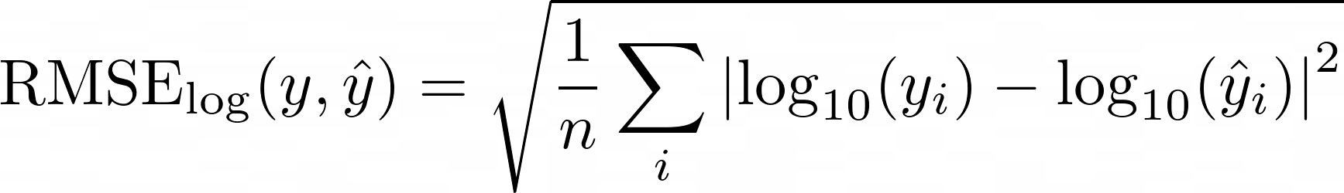
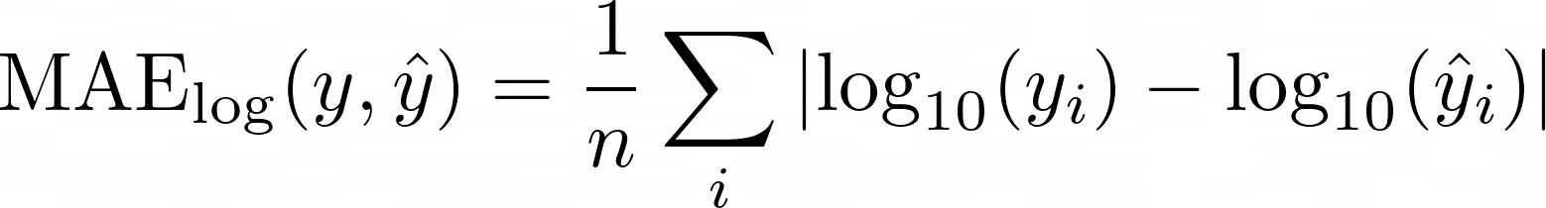
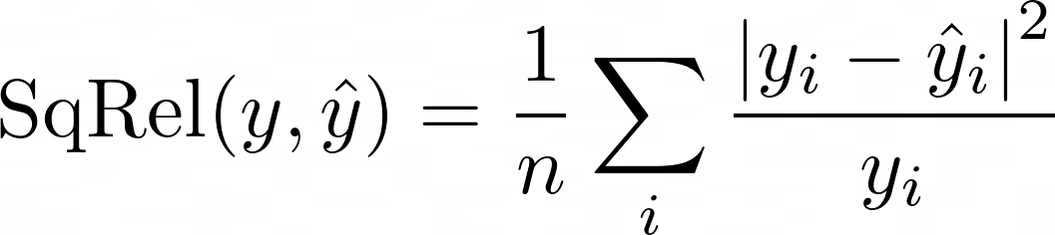
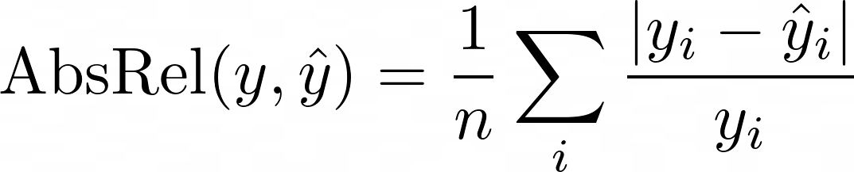
Metrics

Slide 33
Introduction
Related works
Proposed methods
Dataset and metrics
Experimental results
Conclusion

Slide 34
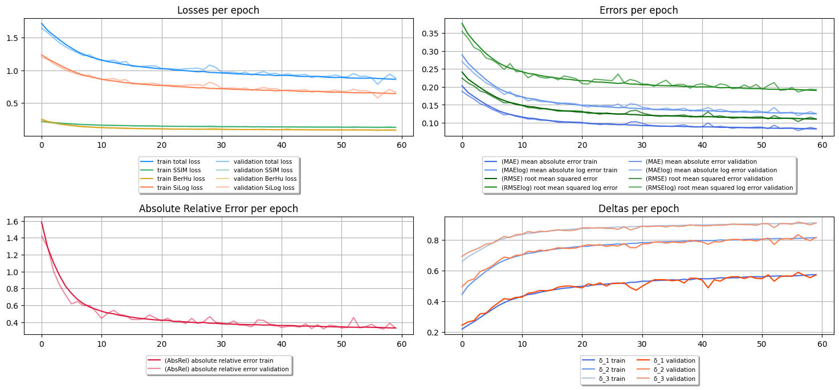
Training and validation metrics trend

Slide 35
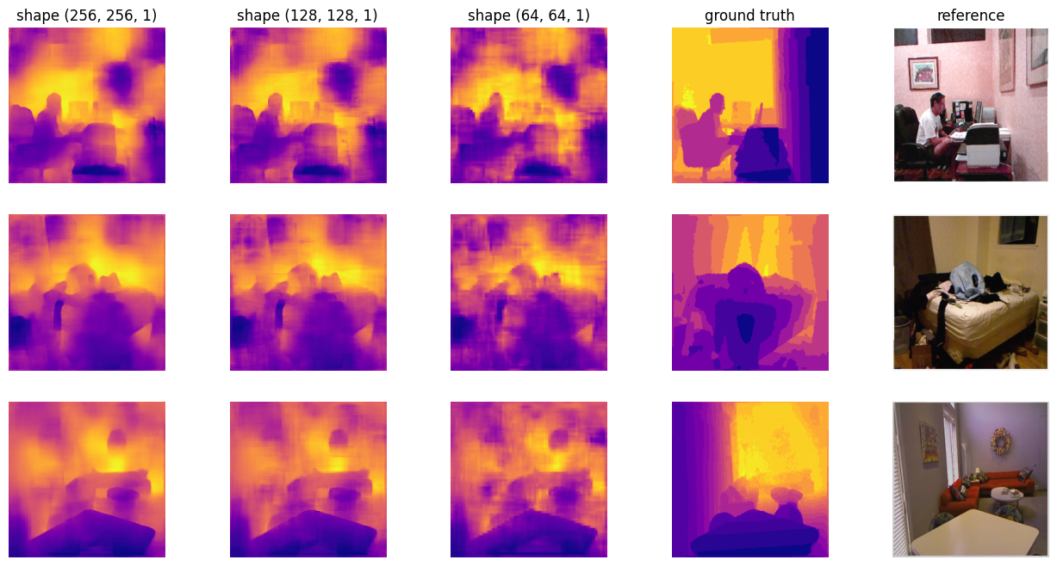
Batch predictions – Train mode

Slide 36
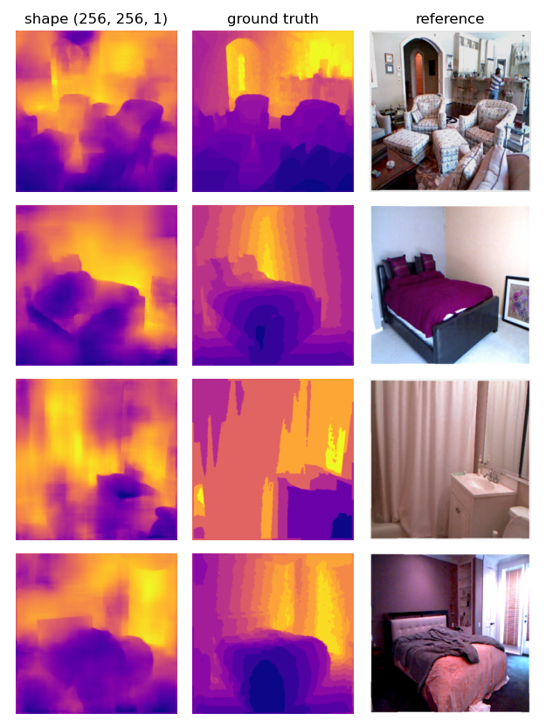
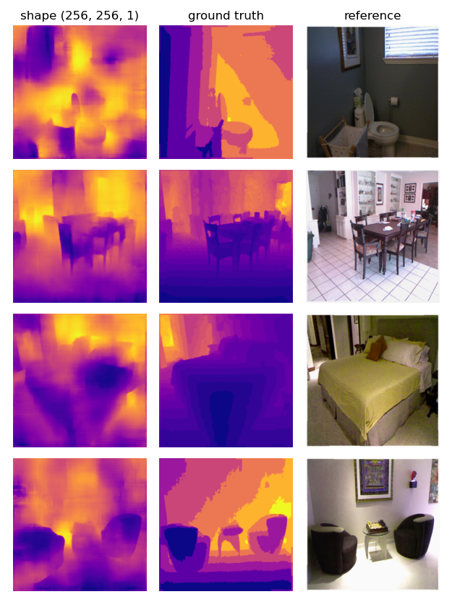
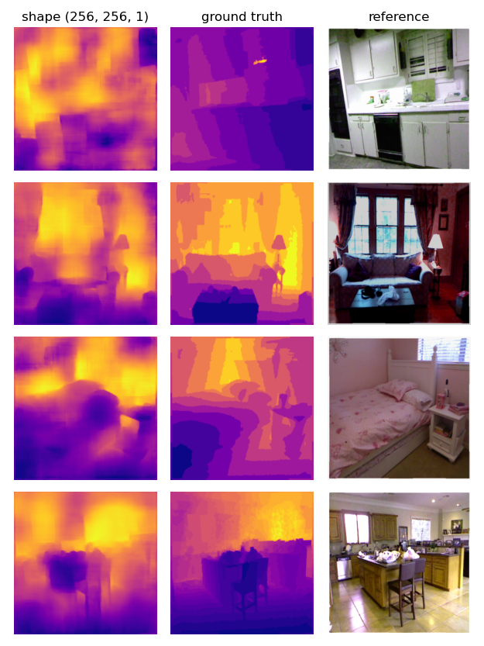
Batch predictions – Eval mode

Slide 37
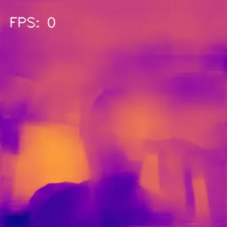

Slide 38
The lightweight model
Model | Checkpoint size | Model size | Quantized model size
MonoDeRT | 21.97 MB | 7.31 MB | 1.89 MB
RT MonoDepth | 67.74 MB | 23.12 MB | /
Unet (4 layers) | 63.00 MB | 21.50 MB | /

Slide 39
Introduction
Related works
Proposed methods
Dataset and metrics
Experimental results
Conclusion

Slide 40

Conclusions
MonoDeRT is a lightweight pyramidal encoder decoder with residuals that performs prediction in real-time.
Due to its nature it’s easy can be easily deployed in embedded devices.
Due to its simplicity improve the architecture is quite easy.

Slide 41
Conclusions
MonoDeRT is a lightweight pyramidal encoder decoder with residuals that performs prediction in real-time.
Due to its nature it’s easy can be easily deployed in embedded devices.
Due to its simplicity improve the architecture is quite easy.

Slide 42
Conclusions
MonoDeRT is a lightweight pyramidal encoder decoder with residuals that performs prediction in real-time.
Due to its nature it’s easy can be easily deployed in embedded devices.
Due to its simplicity improve the architecture is quite easy.

Slide 43


